Slide 1
Having community conversations that matter - what works in community engagement?
Dr Claire Bynner
Research Fellow, University of Glasgow
Research Team Leader,
@claire.bynner @@WWScot @CnScotland
South Lanarkshire Community Planning Partnership Conference 2019

Slide 3
community engagement
in context

Slide 4
Democratic Recession
Global Attitudes Survey shows increased indifference, frustration and authoritarian attitudes particularly in the youngest democratic systems around the world (Foa & Mounk, 2016)
Support for regime institutions - government and parliament has declined esp. in countries with high levels of youth unemployment (Janmaat 2019)
Dramatic declines in political trust and voting levels (Janmaat 2019)
People like the idea of democracy, but despair at how it is practiced (Economist Intelligence Unit's Democracy Index 2016)
Notes:
number of “full democracies” dropped from 20 to 19 (USA now classed as “flawed”)
around half the world's population (49.3%) live in a democracy of some kind. But only 4.5% of people live in a “full democracy” - half as many as in 2015
Democratic principles

Slide 5
In recent years there have been sharp increases in the numbers of young people participating in demonstrations (Janmaat 2019)
Notes:
ESS, Eurobarometer and World Values Survey - YP support for regime institutions - government and parliament has declined esp. in countries with high levels of youth unemployment . Dramatic declines in political trust and voting levels and sharp increase in participation in demonstrations. Support for democracy as a system of government is less effected and more immune to shocks - although for the youngest group there are signs of decline

Slide 6
Evolving role of citizens: 2 stories can be told
Story of decline
Story of progress
Declining…
Voter turnout in elections
Trust in & legitimacy of traditional institutions of public life (e.g. government, media, parties, unions, community associations, etc)
Social capital: community ‘ethos’ & networks
(Dalton 2005; Putnam 2001)
What’s happening is that citizens are becoming:
better educated, more knowledgeable and critical;
less deferential to traditional authority and elite-driven / hierarchical forms of governance;
dismissive of conventional channels and engaged in alternative mechanisms of political expression;
The myth of public apathy
(Norris 2002;Castells 2012;Eliasoph1998)

Slide 7
The myth of public apathy
Civic participation in Scotland
Record-breaking participation in the Scottish independence referendum
A vibrant civil society / third sector: social enterprises, development trusts, housing associations, transition towns, community anchor organisations (see Escobar et al 2018; Henderson et al., 2018)
Survey data suggests that civic participation is on the rise: 55% in 2009; 61% in 2013; 69% in 2015 (Marcinkiewicz et al., 2016; Reid et al., 2013)

Slide 8
A ‘silent crisis’ of local democracy?
Scotland has the largest average population per basic unit of local government of any developed country (Keating 2005)
Average population per LAA:
Finland=15,960; France= 1770; Germany= 7,080; Spain= 5.680; EU average= 5,630
Scotland= 163,200
Alongside England, Scotland has some of the lowest voter turnout at local elections in the EU
Ratio Elected Members/ Citizens represented:
Finland= 1/500; France 1/125; Germany:1/400; Spain 1/700; UK= 1/2860
Scotland = 1/4270
A ‘silent crisis’ of local democracy? (Bort et al 2012)

Slide 9
Participation in local decision-making in Scotland: deficits and aspirations (Scottish Social Attitudes Survey 2015 + Ipsos Mori 2014)
35% of Scottish citizens said they feel part of how decisions affecting their community are made
96% said that people should be involved in making decisions about how local services are planned and run
80% said that people should be involved in deciding how money is spent on local services
77% said would get more involved in their community if it was easier to participate in decisions that affect it

Slide 10
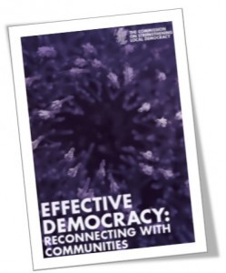
2014 COSLA Commission on Strengthening Local Democracy:
There is a link between the absence of strong local democracy and the prevalence of inequalities
It is communities that empower governments at all levels, not governments that empower people”

Slide 11
Skerratt, S.
Notes:
See also the proposals in Education (Scotland) Bill (consultation just launched 7th November) The Bill will improve parental and community engagement in school life and in learning outside of school, and strengthen the voice of children and young people, by actively promoting and supporting pupil participation

Slide 12
Policy and research context in Scotland for community engagement
Local Governance Review (> Local Democracy Bill?)
Review of Community Councils (2017-2018)
Places, people and planning – Position Statement 2017
Open Government Partnership
Re-launch of the National Standards for Community Engagement (2016)
Community Empowerment (Scotland) Act 2015
Participatory Budgeting national programme (2014-2018)
COSLA Commission on Strengthening Local Democracy (2014)
Parliamentary Local Government Committee (2013, 2014)
National Planning Framework 3
Christie Commission on Future Delivery of Public Services 2011
Audits of Community Planning Partnerships (2011, 2013), Reviews of Community Planning (2012, 2016)

Slide 13
Prevention
Performance
Partnership
Participation
Place

Slide 14
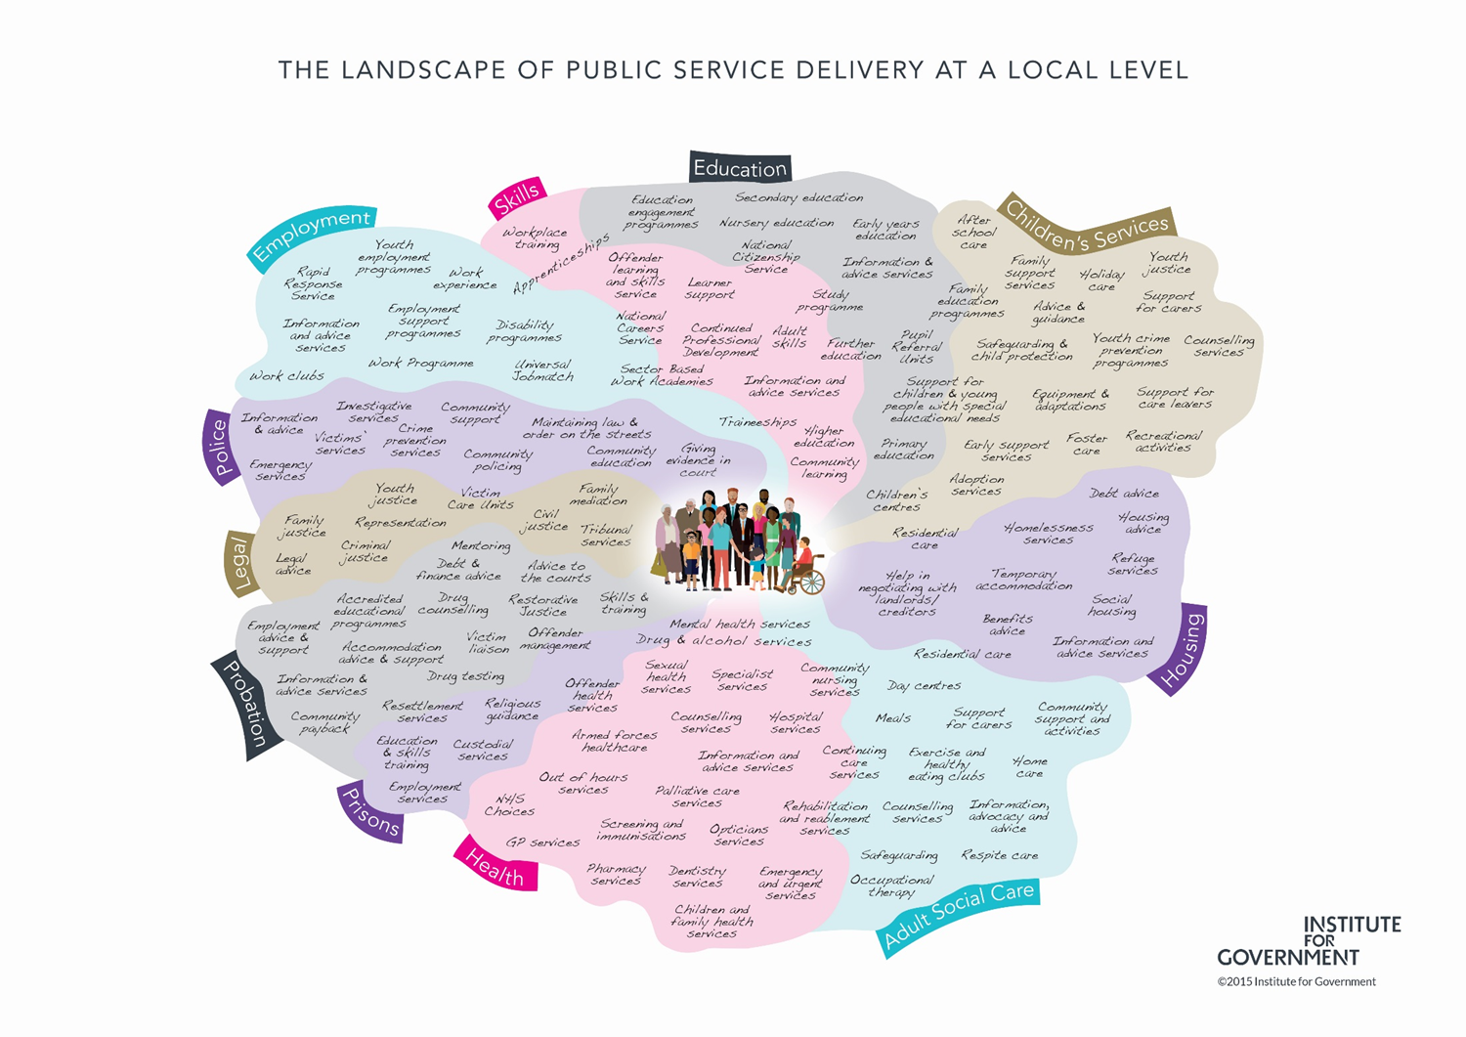
Place provides a focus for partnership

Slide 15
….and for participation

Slide 16
Participatory governance
governance through effective partnerships across sectors, as well as meaningful and consequential participation by citizens and community groups’
(Escobar et al 2017)
Across the globe partnership and participation are used as strategies to close the participation gap and improve outcomes

Slide 17
But is all participation good?
Dalton (2018) argues that there is a
widening participation gap between
‘the politically rich and the politically poor’
unless corrective measures are taken “participation of all varieties will be skewed in favour of those with higher socioeconomic status and formal education”
(Ryfe & Stalsburg 2012)

Slide 18
In the last 12 months, have you participated in a local forum to discuss policy or community issues?

Slide 19
Stay standing if at that forum there was a reasonable…
…gender balance
…mix of personal and professional backgrounds
…range of perspectives and opinions
… age range (i.e. 3 generations)
… income range
…sense that most participants felt included and influential
…sense that most participants enjoyed it
… sense that their participation would have a clear impact

Slide 20
Key challenges in organising public participation processes
Inclusion and diversity
Quality of dialogue and deliberation
Impact: clear link to decision making

Slide 21
What Works in public participation?

Slide 22
3 components of ‘what works’ in public participation
Multi-channel
Inclusive & deliberative
Empowered & consequential

Slide 23
Multi-channel
Developing a variety of channels for participation:
online, face to face, combined
light-touch vs. intensive
‘crowdsourcing’: tapping into ‘the wisdom of the crowds’ (Surowiecki 2005)
Open Government (Noveck 2015)
Trailblazers:
Better Reykjavik
Decide Madrid / Madrid Listens / Laboratories for Citizen Innovation
Crowdsourcing legislation in Taiwan

Slide 24
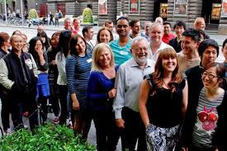
Inclusive AND deliberative
Inclusion and diversity are crucial for meaningful, legitimate and effective participation
demographics AND perspectives
lowering barriers to participation
Deliberative engagement is about:
assessing evidence
hearing & scrutinising different views
then, making informed decisions
Trailblazers:
Melbourne Citizens’ Panel

Slide 25
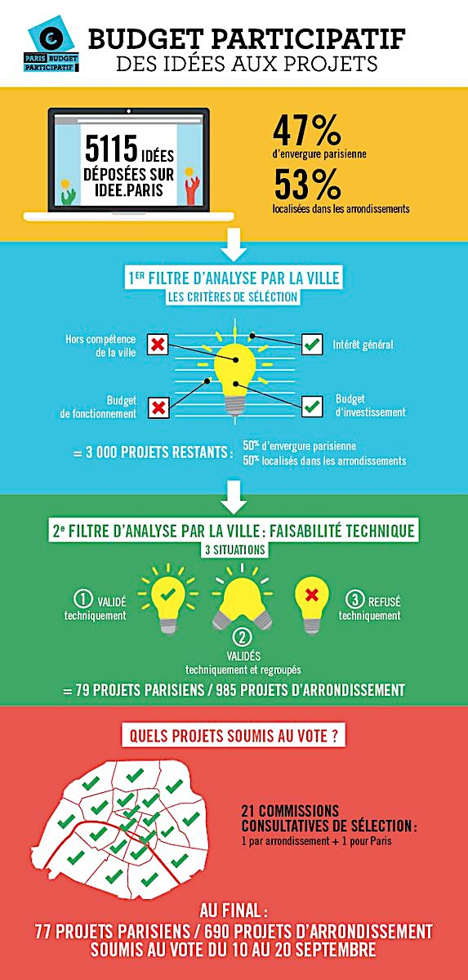
Empowered and consequential
Participation thrives when important issues and resources are at a stake, and citizens feel their contribution can actually make a difference
Trailblazers:
Participatory Budgeting, from Porto Alegre (Brazil) to over 3,000 localities around the world
Paris Participatory Budget
Notes:
Paris example

Slide 26
Example: Participatory Budgeting in Scotland
Participatory Budgeting (PB) a process by which citizens decide collectively how to spend public money
Combines two policy agendas: community empowerment and social justice.
In 3 decades PB has grown from a local innovation in Brazil to a global movement
In Scotland grassroots growth of PB - accelerated by political, legislative and policy support (over 200 processes by 2018)
1st generation PB – dominated by community grant making
2nd generation PB aspirations for mainstream public budgets
Notes:
The WWS survey of Community Planning Officials shows that 55% of respondents have been involved in organising PB, which illustrates the spread of PB schemes in Community Planning.

Slide 27
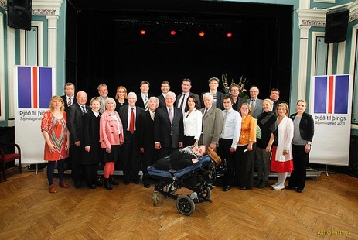
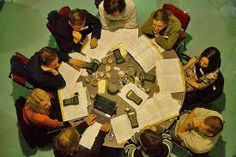
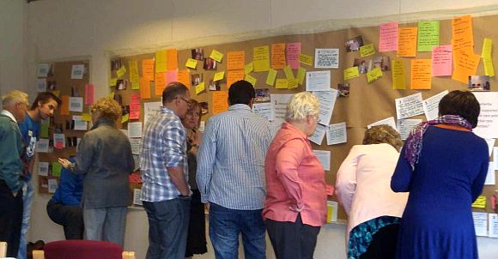
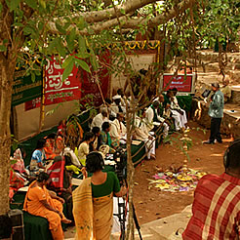
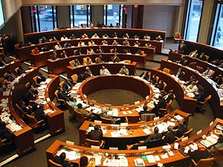
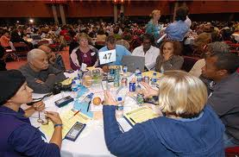
Examples of deliberative processes: Mini-publics

Slide 28
What is a ‘mini-public’?
‘minipopulus’ - an assembly of citizens, demographically representative of the larger population, brought together to learn and deliberate on a topic in order to inform public opinion and
decision-making
(Dahl, 1989)

Slide 29
Mini-publics: Key features of the process
Selection: participants selected randomly or quasi-randomly (often stratified sampling)
Lowering barriers to participation: e.g. stipend, childcare, transport, accomodation
Facilitation: fostering deliberative dynamics and dialogic communication
Learning phase: participants call in contributors/‘witnesses’ to present testimonies and evidence: activists, stakeholders, experts, politicians, civil society, business…
Deliberative phase: participants deliberate in light of evidence and testimonies > re-examining own preferences/views/positions
Decision-making phase: reasoned conclusions or recommendations made after considered judgement

Slide 30
The City of Melbourne People’s Panel (2014)
Composition: 43 members randomly selected from the population (50/50 split between residents and business owners)
Task: scrutinise 10-year financial plan worth $5 Billion (in light of $1.2 Billion gap)
Principles provided by the Municipality: to be specific, realistic and forward thinking and for their ideas to be sustainable, achievable, relevant to the challenges and to add value to the city
Broader community and stakeholder engagement process feeding into the Panel
Result: 11 recommendations embedded the Council’s 10-year financial plan, including spending and revenue priorities

Slide 31
More examples
Mini-publics for community budgeting:
North Marr in Aberdeenshire https://participedia.net/case/5640
Barking and Dagenham :
https://www.involve.org.uk/resources/blog/opinion/what-citizen-participatory-grant-making-barking-and-dagenham
WWS mini-publics examples and resources: http://whatworksscotland.ac.uk/topics/mini-publics/

Slide 32
Growing community of practice in Scotland and around the world
Citizen Participation Network http://www.aog.ed.ac.uk/engagement/citizen_participation_network
Scottish Health Council www.scottishhealthcouncil.org/home.aspx
Involve (UK) www.involve.org.uk
Participatory Budgeting Scotland http://pbscotland.scot
Engage 2020 Action Catalogue http://actioncatalogue.eu
International Association for Public Participation www.iap2.org
International Observatory on Participatory Democracy http://www.oidp.net/en/home
Journal of Public Deliberation (open access) http://www.publicdeliberation.net/jpd/
National Coalition for Dialogue and Deliberation (USA) http://ncdd.org
New Economics Foundation www.neweconomics.org/programmes/democracy-and-participation
New Democracy Foundation (Australia) https://www.newdemocracy.com.au
Open Government Partnership http://www.opengovpartnership.org
Participation compass http://participationcompass.org
Participatory Budgeting Network (UK) http://pbnetwork.org.uk
Planning Aid (Scotland) http://pas.org.uk/
Public Conversations Project (USA) www.publicconversations.org
Public Dialogue Consortium (USA) http://publicdialogue.org
The Center for Deliberative Democracy http://cdd.stanford.edu/polls/. See in particular ‘Deliberative Polling: An Executive Summary’ and Videos.

Slide 33
Community conversations that matter

Slide 34
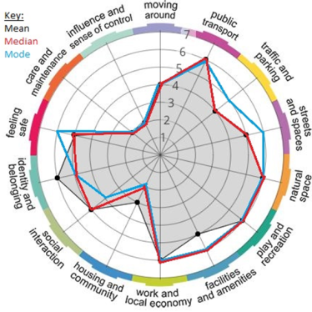
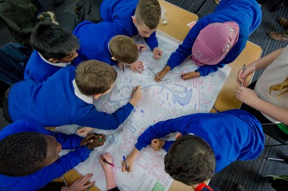
We have new and innovative methods and techniques …

Slide 35
We have high standards for processes….

Slide 36
Having community conversations that matter will require…
But…….. we must invest in institutions and infrastructure
democratic innovation
new approaches, processes and institutions that enable inclusive forms of decision-making through co-production and deliberation
and facilitative leadership

Slide 37
21st Century Politicians
Traditional leader | Facilitative leader
Hierarchies | Networks
Certainty (knows everything) | Openness (constant learning)
Leads others | Helps others to lead themselves
Good at talking | Good at listening
Knows the direction | Knows how to help others to work out the direction
Commanding and controlling | Facilitating and mediating
Builds alliances to win policy battles | Builds alliances to find workable policies and solutions

Slide 38
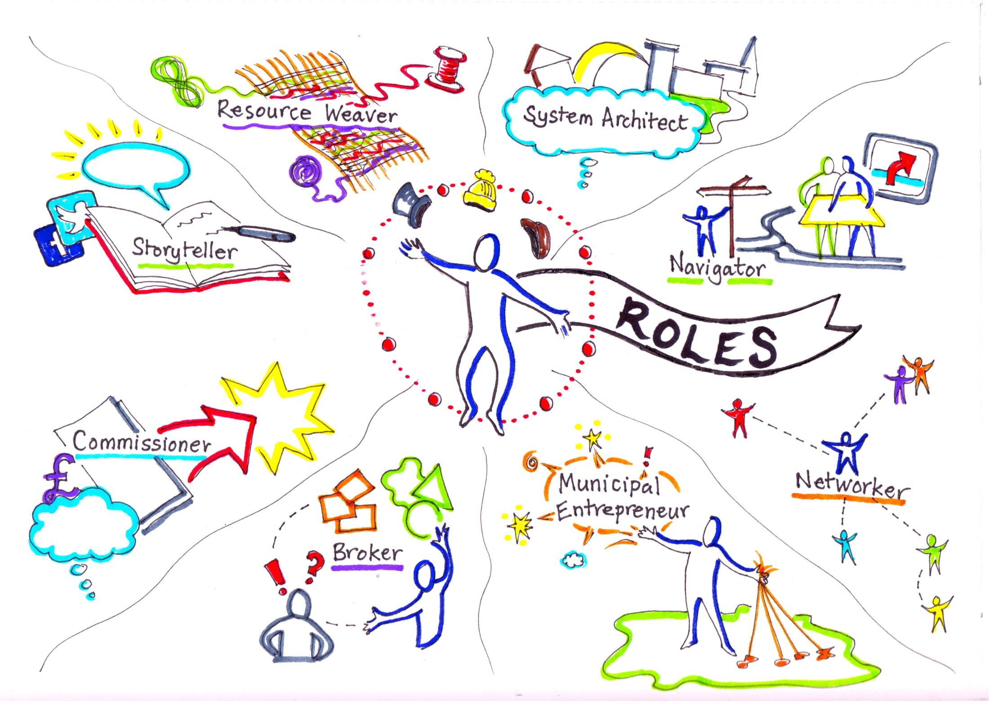
21st Century Public Servants
Notes:
Slide replicated from work by Catherine Mangan, Catherine Needham and Helen Dickinson (University of Birmingham) –Project: The Twenty-first Century Public Servant/
Important role of these professionals as boundary spanners and democratic innovators

Slide 39
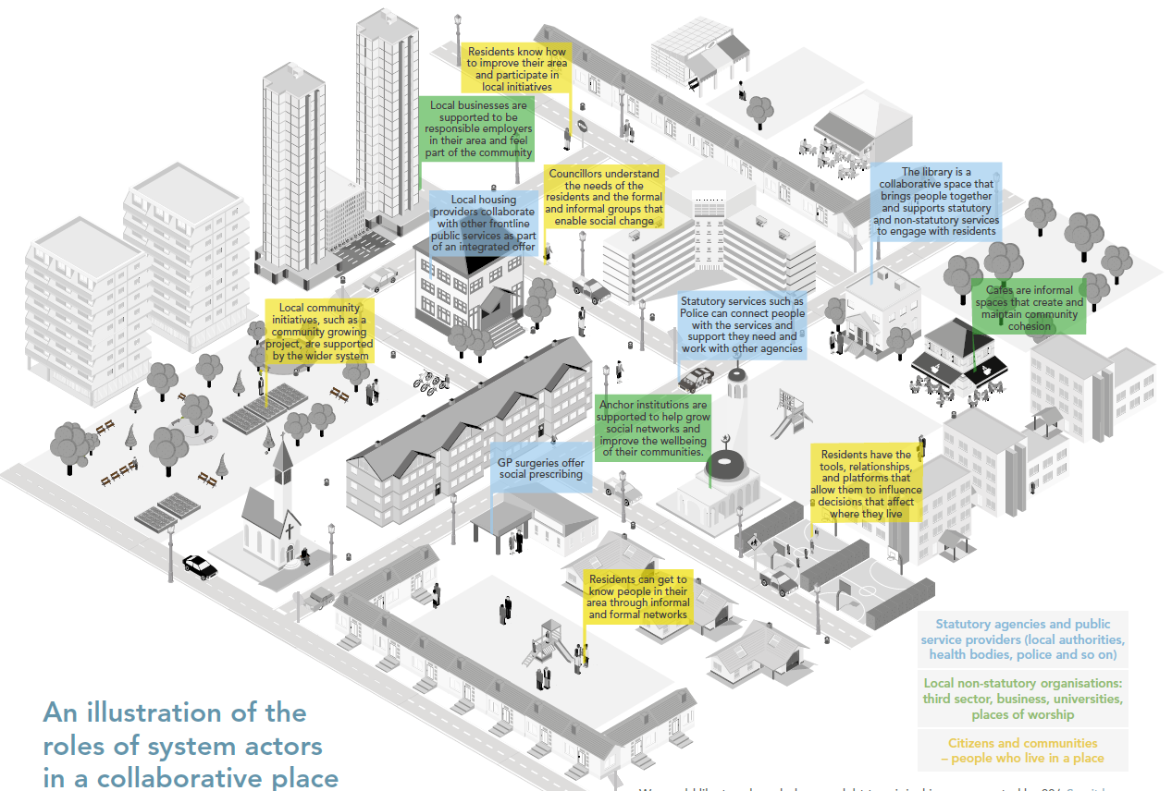
Collaborative places
Randle, A. & Anderson, H. 2017
Notes:
There is currently a sense of public participation being a disjointed activity. This is where we want to be – coherent connected collaborative places – supported by the wider system

Slide 40
Key challenges
Reshaping mindsets and ways of working
commitment to democratic innovation from officials, elected representatives, community groups and citizens
facilitative leadership
Inequalities of power and influence within communities
local authorities have a key role in lowering barriers to participation and creating a level-playing field
democratic innovations can clash with established relationships and dynamics in communities
Investment in developing:
capacity and skills: facilitation, process design, mediation, negotiation, brokering, etc
infrastructure (e.g. spaces, platforms)
Long-term commitment, ongoing learning and adaptation

Slide 41
Concluding Messages
Empowerment is not something that can be done to others, communities and individuals can only empower themselves
But CPPs can develop
enabling conditions, governance structures, capacity, infrastructure and spaces for democratic innovation
The challenge is to connect decision-making processes, facilitators and innovations
And to engage future generations in building a stronger local democracy
Notes:
How does the community plan fit with decisions taken in committees and at the CPP board level?
From innovations that are disconnected to system change

Slide 42
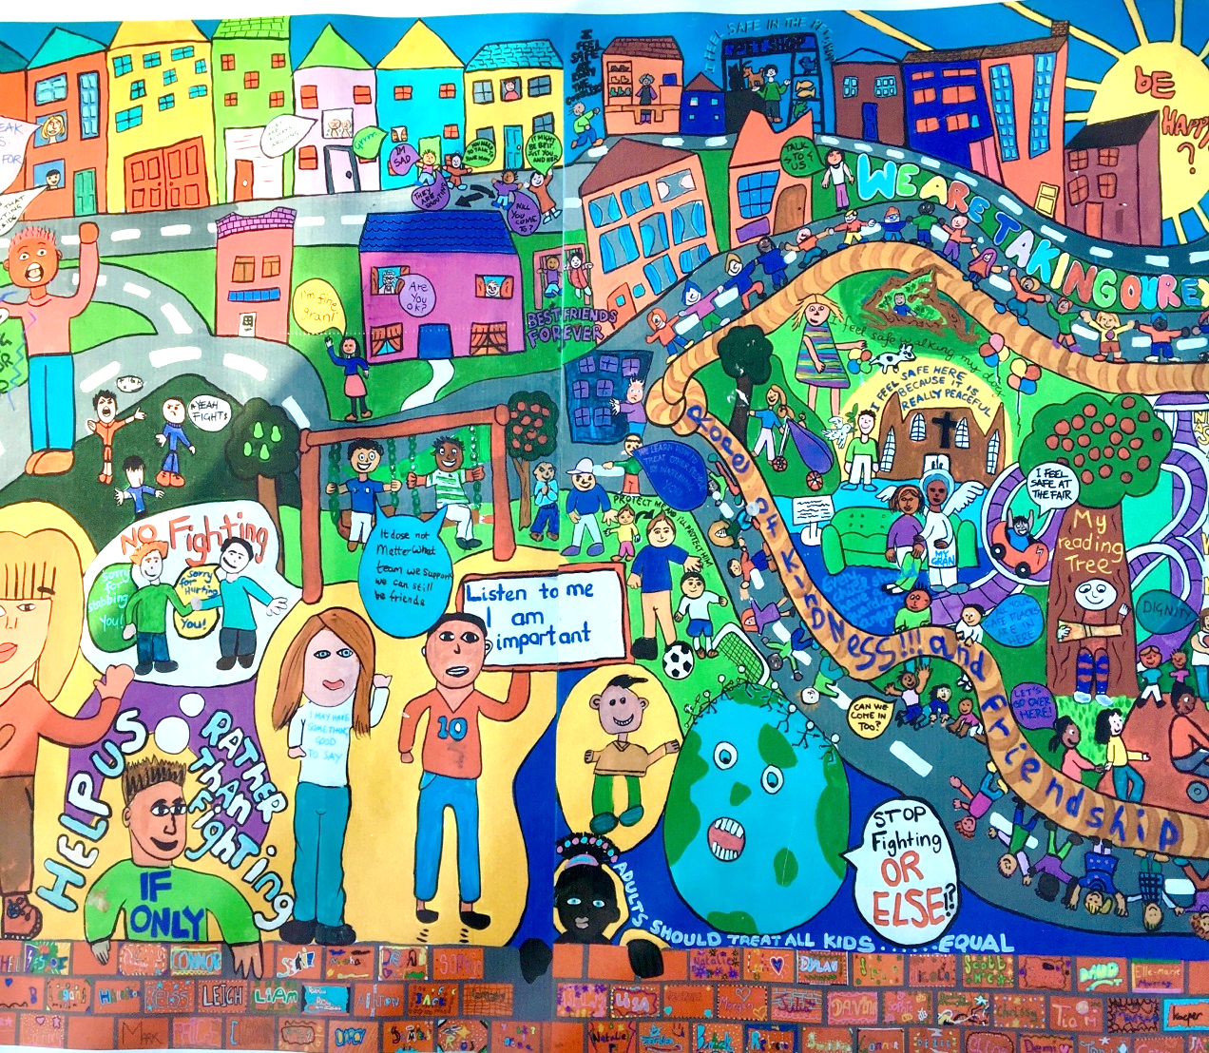
Image from banner made by Children’s Parliament and Dalmarnock Primary School

Slide 43
whatworksscotland.ac.uk
@ClaireBynner
Notes:
Key WWS reports and events to look out for:
CP Officials survey
Community Anchors report
Community Engagement Inclusion Review - What Citizens Want
Making Data Meaningful report

