Slide 1
Welcome/Context
Beginning of process to build next CSP 2020-23
Want to triangulate evidence as part of the process
Data
Lived experience/service user engagement
Staff perceptions

Slide 2

South Lanarkshire data reflections

Slide 3
Purpose of today’s session
Identify important data aspects of the current planning context
Look at the key demands of being data informed
Test out our shared approach to understanding our (current) shared data
Scoping of additional essential data that builds our understanding of need
Organise and agree how we gather the agreed data we need to write a meaningful CSP 2020 - 23

Slide 4
3 Exercises
Shared dataset Corporate Parenting and Child Protection
Children’s Services Plan Dashboard
Other essential data we need to analyse

Slide 5
Implementing Change
Evidence
Context

Slide 6
Is about using evidence and data to prompt useful discussion and to inform effective decision-making.

Slide 7

Improving outcomes for children
Working effectively together
Planning future service delivery
Based on needs (and strengths) of individuals and communities
Efficient spending and effective (dis) investment
Using delivery models that can be meaningfully evaluated

Slide 8


The National Performance Framework and UN Sustainable Development Goals

Slide 9


www.nationalperformance.gov.scot
https://sustainabledevelopment.un.org/

Slide 10
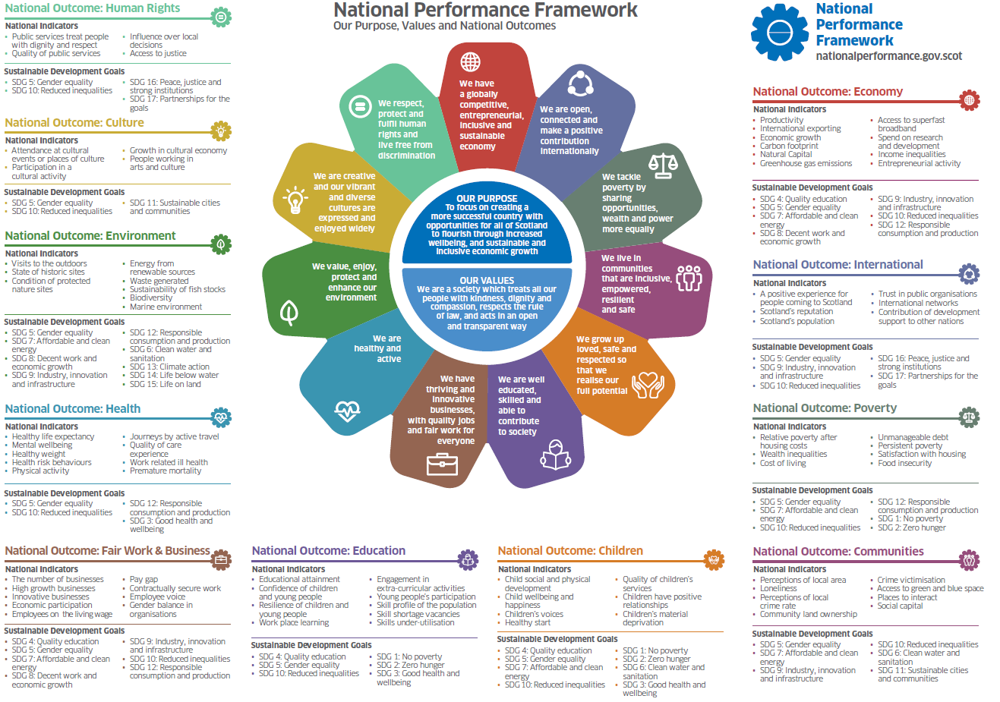
11 Outcomes, 81 Indicators and linked SDGs

Slide 11

What are the different elements of the NPF & what can they tell us? National Outcomes
11 National Outcomes: These describe the features of the kind of Scotland we want to create as a consequence of our collective actions. They are population level end results we want to be experienced by the people of Scotland. They have a statutory basis in the Community Empowerment (Scotland) Act 2015.

Slide 12
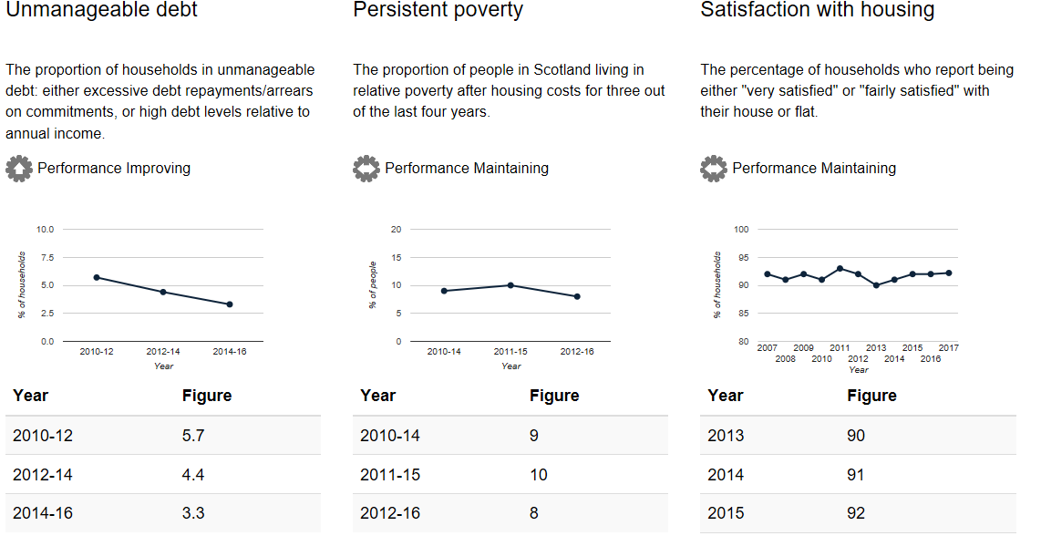
Definitions: What are the different elements of the NPF & what can they tell us? National Indicators (2)
81 National Indicators: Give a broad picture of progress towards the outcomes on some important measures (at the national level and also for population sub-groups).
While they are important to measure, they are not the only important measures of progress towards Scotland’s National Outcomes, and whether Outcomes are being realised for all requires exploration of performance differences and gaps between groups.
There are risks and unintended consequence of focussing too much on the Indicators themselves rather than the Outcomes; the Indicators are best seen as one important source of evidence that paint a broad picture of “how we’re doing” socially, economically, and environmentally.

Slide 13

Where are we on the NPF journey?
In Statute – The Community Empowerment (Scotland) Act 2015 places a duty on Scottish Ministers to consult on, develop and publish National Outcomes for Scotland and to review them every five years.
It also places a duty on public authorities to have regard to the national outcomes in carrying out their functions.
Belongs to the whole of Scotland, not just an SG framework. Everyone has a role to play in contributing to the delivery of the National Outcomes.

Slide 14
Joint Strategic Needs Assessment
2019
South Lanarkshire Stakeholder event

Slide 15
Joint Strategic Needs Analysis
Purpose – to begin the process of developing an enhanced JSNA
This is the responsibility of the children's services partnership as part three of the act
Plan to have this in place by September /October
Feeds in to the Children's services Strategy (June 2020)
Notes:
In undertaking the JSNA , the children's services partnership will have the opportunity to align with other parts of the local system within the Community planning partnership . As part of this, partners can consider joint commissioning opportunities with other local bodies, thereby enabling joined-up interventions and alignment of resources in tackling issues that will benefit from multi-agency working, for example, reducing re-offending, improving housing options for LAC, or child safeguarding. Such local alignments will help the partnerhsip to take an overview over how the impact issues have on families, children and young people and how they could be better addressed across the spectrum of local services. Some of these relationships and partnerships may already exist in some themes, but some partners may will wish to build upon these or establish improved ways of working. These relationships can be mutually beneficial for local services, and the partnership may help local partners to achieve their own aims through joint working. For instance, initiatives to support mums who have their children removed on numerous occasions action to work with the mum may break the cycle and have a positive impact on their health and wellbeing , as well as reuding the cost of future children being place in care and then onto permannet placments.

Slide 16
What is a JSNA?
Describes comprehensively the level of need for children , young people and families
Describes the strategic direction of services to meet improved outcomes in partnership with parents/carers , children and young people and practitioners
Includes how we work with the third sector to develop services
Based on wide range of current information, data and evidence
Includes the need for workforce development
Joint Commissioning based on the needs identified

Slide 17
What are the challenges?
Collecting the relevant data, that includes process and outcome data
Identifying the resource to deliver the priorities

Slide 18
What do we want from you?
Your ideas and feedback on the data presented
Views on local needs and priorities
At a later stage
Information on local strengths and assets
Help to develop a local narrative for JSNA
Notes:
Our involvement – to try and ensure the wider context to children's services is covered
We have lots of information to present , but for today we will be focussing on some of the headlines, and what we would like from you is to know whether or not this reflects the views and issues in your service.
Is there an explanation for why things are the way they are? Is it good or bad? Improving
We’d like to hear from you what you feel are the key priorities or most important issues, if there is anything missing and if so what should we be including?

Slide 19
Session One: Shared Data set
Split into 2 groups . Consider what's the data telling us for each measure .

Slide 20
Session Two: Children’s Services Plan Dashboard
Where are now – current status?
What areas are we worried about and need to be carried forward to the new plan?

Slide 21

Tea and Coffee

Slide 22
Additional Data
What other data do we have?
What other data do we need?
To make informed decisions about our new Children’s Services Plan

Slide 23
Session Three:
Write on a post it, (or just write on the relevant flipchart). Match the other data we have to where you think it best sits- against out current high level themes:
Early Support and Prevention
Health and Wellbeing
Vulnerable Groups and Keeping Children Safe
Other
NB has to be data you know we have, who has it and we can access it easily.

Slide 24
Who is missing from this process?
Identify who isn’t here that needs to be part of this part of the CSP process - discuss

Slide 25
What happens next
We gather agreed data into one place
Task staff to take away manageable data sets to analyse
Bring/send back the data we want to understand better
Apply our ‘intelligence’ to the agreed data
Proposed next meeting 27 August (time tbc)

Slide 26
Thank You

