Slide 1
Getting It Right For South Lanarkshire’s Children
Data and Planning Group
October 2019

Slide 2
Purpose
To provide a brief on preparation for inspection in relation to data available to and used by the children’s services partnership
Notes:
Inspection demands and our shared preparations, maybe the Children's Rights Report a new duty and one we fully embrace –explicit in our 2nd annual report of the CSP, our desire to make our CPS 2020-23 better than our current plan maturing approach to understanding data trends, step change requirements in the LCPAR demand to shift spend and do things differently, how do we reconcile with existing demands and finite resources?

Slide 3
How good is the partnership at..
5 Inspection Questions
...responding when a child and young people need protection
...helping children and young people who have experienced abuse and neglect stay healthy and well and recover from heir experiences
...maximising the wellbeing of children and young people who are looked after
...enabling care experienced young people to succeed in their transition to adulthood
How good is collaborative leadership

Slide 4
Children’s Services Plan Vision
Children and young people will be safeguarded and supported to reach their full potential and thrive within their communities.
Notes:
Our vision, developed through consultation with stakeholders at Senior Manger’s and Locality Practitioner events in late 2016. It’s much more succinct and straight to the point than the previous vision. It’s on posters around council and partner buildings and we work hard to emphasis the vision at training events and presentations.
This is a slide that is almost a prerequisite for any PowerPoint presentation we give, along with the Governance Structure and Priorities and Core Comittment slides.

Slide 5
Governance
Notes:
The latest governance structure following an annual partnership review of how we work together. A Neglect Sub Group has been added to thematic groups at the centre, which are responsible for driving forward key partnership activity.

Slide 6
Background
The Children and Young People Scotland Act 2014 places a duty on CPPs to have a “Children’s Services Plan”, prepared in accordance with the provisions of Part 3 of the Act, in place by 1 April 2017
Improvement driven plan informed by understanding available data
Notes:
Key legislation setting out the landscape for our Children’s Services Plan is the Children & Young People’s (Scotland) Act - part 3 sets a 3 year planning cycle for CSP’s with an annual report and final report required to be published and submitted to the Scottish Government reporting on progress.
Our current plan is a bit of a ‘step change’ in that it is driven by available data and in particular the trends that are causing concern, or where we know we can and have to do better.

Slide 8
Children’s Services Plan 2017-2020 Priority Outcomes
Prevention and early support - Children have the best start in life and are supported to realise their potential
Health and wellbeing - The health and wellbeing of children, young people and families is improved
Supporting vulnerable groups and keeping children safe - The life chances of our children with additional support needs and our most vulnerable children and young people are improved
Notes:
These are the three key organisers for the CSP – high level themes and intended outcome for each theme. Reflects the shift nationally to prevention and early intervention, the GIRFEC wellbeing focus and our safeguarding and corporate parenting duties.

Slide 9
Our Core Commitments
Tackle inequality, discrimination and poverty
Promote early support and prevention
Meaningful participation and engagement
Working together to maximise impact
Multi-agency continuous improvement
Build a competent and confident workforce
Notes:
Some of the core commitments are explicit in the Children’s Services Plan e.g. the Prevention and Early Support Theme activity, or Locality Events for practitioners e.g. the May events were built around Mental Health & Wellbeing training and awareness raising as this is a fast moving landscape currently.

Slide 10
Children’s Services Plan 2018-19
Theme 1: Prevention and early support
256 Tobacco brief interventions by Health Visitors in EK reduced exposure to second-hand smoke at six weeks contributing to the reduction from 8.8% in (2018) to 6.6% recorded at the 27/30 month Child Health Review
Further increase in Free School Meals award, now 97% of pupils (82% 2018) of pupils*
Health Visitor/Midwifery ‘routine enquiry’ supporting financial inclusion for families worked in partnership with money matters advice service achieving a (£100k increase in household income -sample of 20 diverse families)
Staff in 82 establishments have been trained in the Catch Up Literacy programme impacting positively on literacy levels and reducing the attainment gap between SIMD 1 and 5 at all levels (1st level 24% to 17%, 2nd level 26% to 24%, 3rd level 19% to 9%)
Youth Employability Aspire – best post school destination results ever 95.8% (Sco 93.7%) and 93.2% (Sco 90.4%) in the most deprived areas
Notes:
There are 127 indicators, actions and measures contained in our Children’s Services Plan, the next few slides are a selected snapshot of some of this work. Further detail can be found in our 2nd Annual Report.
Free School Meals, we have almost 100% (6910 pupils) registration for FSM, the best it has ever been. The next challenge will be to develop strategies to increase the usage of this award, particularly by secondary school pupils. This will be part of our developing approach to Cost of the School Day activity and encouraging pupils to stay in school or lunch will be an integral part of this plan. Staff hours have been dedicated to driving Cost of School Day forward and to supporting our schools implement local actions.
Our Youth Employability programme has provided fantastic results, best ever school leaver destinations, with better over all destination rates and nearly 3% better in our most deprived areas (SIMD1). Aspire support workers and the Foundation Apprenticeship and Gradu8 programmes provide a model of intervention that allows for bespoke supports to be tailored for individual young people both in the Senior Phase and post school.

Slide 11
Children’s Services Plan 2018-19
Theme 2: Health and wellbeing
281 staff and 105 parents engaged in attachment training (FAIAR) 37% increase on last year’s participation
Parenting Support Pathway – implementation and coordination of key evidenced based programmes in progress, with 58% of children evidencing improved behaviours after parent attended the Incredible Years programme. We also evidenced a 3% increase in children with no emotional/behavioural concerns at 27/30 month stage.
Increased focus on sport and physical activity and mental health 1277 more pupils accessing Active Schools programme compared to 2018. Tiny ACE programme launched - 444 memberships in place supported by Health Visitors.
56 staff in establishments trained to deliver/support the national Low Intensity Anxiety Management Programme with young people
Targeted nurture and transition programmes in schools (550+ pupils)
Young People’s Mental Health Support Pathway Guidance launched
Notes:
The Active Schools programme continues to engage high numbers of pupils in accessing sport and physical activity, making a positive contribution to improving health and wellbeing of our young people. In all 49% of our school roll participate in Active Schools. This represents a positive partnership between South Lanarkshire Leisure and Culture and our schools.
The Tiny Ace initiative programme seeks to establish healthy practices in families from birth that continue into school days and beyond. Established in October 2018 and is offered in partnership with Health Visiting Teams in all localities.
A Mental Health and Emotional Wellbeing Pathway Guidance booklet has been produced for use by the children’s services workforce to improve support to our children and young people and to make it easier to coordinate support offered. This has been well received and is viewed as a valuable resource, partulcarily by our schools. It was launched at a Head Teachers conference in September 2018.
A range of other developing practice includes: LIAM (Low Intensity Anxiety Management) support offered in a number of schools , Involvement in the national Wellbeing Practicum - CYPIC and partners around St John Ogilvie HS this is aimed at improving quality of support offered to (in particular) female pupils and a legacy of the RCS programme. 4 other high schools and a range of partners are also looking at ways to improve support to this target group, albeit at a more local level – without support from the national improvement team.

Slide 12
Children’s Services Plan 2018-19
Theme 3: Vulnerable groups and keeping children safe
Care experienced school leaver destinations best ever positive rate 90% (Sco 81%)
Attendance for care experienced children remains high 89.9% (Sco 92%) and exclusions very low 0.04% - a key focus for the Designated Senior Manger role in schools. Looked after at home pupils attendance increased by 2.2% over previous year
We experienced a reduction in referrals to the Youth Justice EEI model of intervention 83 (276 - 2018)
579 (356 - 2018) staff benefited from training around gender based violence– additionally every Police Officer in South Lanarkshire trained in the new Domestic Abuse Act (makes child involvement an aggravating factor for first time!)
Pre-birth child protection registrations as a result of substance misuse is variable 44 (34 2018) and work continues to focus on recognition and early response. Contributing to an overall reduction of 4% in the percentage of children affected by substance misuse on the register.
Notes:
As an integral part of the Corporate Parenting Action Plan schools have implemented the duties of the designated senior managers/named persons role in all establishments with a focus on attendance of looked after pupils. And especially the @HOME pupils highlighted as a priority group as part of the RCS work.
The Designated Senior Manager training includes an extensive information pack which will be uploaded to the Inclusion tile on GLOW.
There have been 10 Designated Senior Manager training sessions so far. This has supported improved attendance and attainment of pupils, reduced exclusions and sustained positive leavers’ destinations for care experienced children and young people, enabling them to have improved life opportunities.
As part of South Lanarkshire’s Gender Based Violence Strategy it remains a priority to support staff working with families experiencing domestic violence. This takes a range of forms including specific training events and one off events. The number of staff engaging in training has doubled compared to last year, although the number of individual sessions offed has reduced. E.g. In November 2018 the South Lanarkshire’s Gender Based Violence Partnership held the ‘Inside Outside’ Event at UWS Hamilton International Technology Park which was delivered in partnership with Glasgow Women’s Support Project. xxxxxx

Slide 13
Strong Focus on improvement
Continuous Improvement Group – Action Plan
Calendar of self evaluation activity
Data and Planning Group - Dashboard
Realigning Children’s Services and Children and Young People’s Improvement Collaborative informed – improved use of data!
Children's Services Plan/Local Outcome Improvement Plan(Community Plan) facilitates outcome based reporting–IMPROVE system provides scrutiny
Notes:
An improvement philosophy is central to our partnership and the Children’s Services Plan. Led by the Continuous Improvement Group and can evidence a maturing approach to joint improvement work especially how we use available data to inform our evaluation and planning.
A dashboard of key indicators helps measure progress and the impact of our plan. We are now using this model for other self-evaluation activity e.g. QI 1.1 from the Care Inspectorate’s Quality Framework for children and young people in need of care and protection. This helps understanding of where we are making improvements to the life chances of our children and young people especially those in need of care and protection.
We have engaged enthusiastically with national improvement programme RCS/CYPIC which in turn has increased confidence and competence in improvement practice.

Slide 14
Understanding our data
Vivian Boxall IA

Slide 15
4 key measurement questions
Do you know how good you are?
Do you know where you stand relative to the best?
Do you know where the variation exists?
Do you know your rate of improvement over time?
IHI President and CEO Maureen Bisognano

Slide 16
Why time is important for measurement for improvement
Aggregate measures alone do not lead to predictions about future performance or insights to explain past variations
Looking at data over time allows us to make informed predictions, and understand the impact of changes on our measures so we can take appropriate action

Slide 17
Why do we need data for improvement?
To understand what needs improved
To understand variation
For testing changes
For monitoring progress
To tell the story of your improvement journey

Slide 18
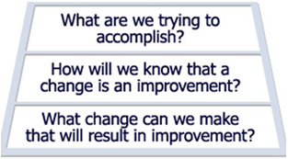
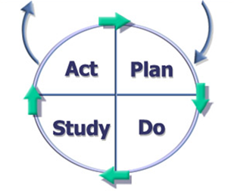
Model for Improvement
Thinking Part
Doing Part
Associates in Process Improvement (API)

Slide 19
How the data is used
Diagnosis: Where data is gathered to understand the process, to see if there is a problem and how big it is.
Improvement: Provides specific information on where in a system to focus improvement work and whether the changes we make are leading to improvement.
Assurance: This provides a fair measure about how well a system is doing – usually against a particular standard.
Performance: Provides specific information on whether targets/objectives are being met.

Slide 20
What do you need to understand?
Relationship
Distribution
Data over time
Compare groups

Slide 21
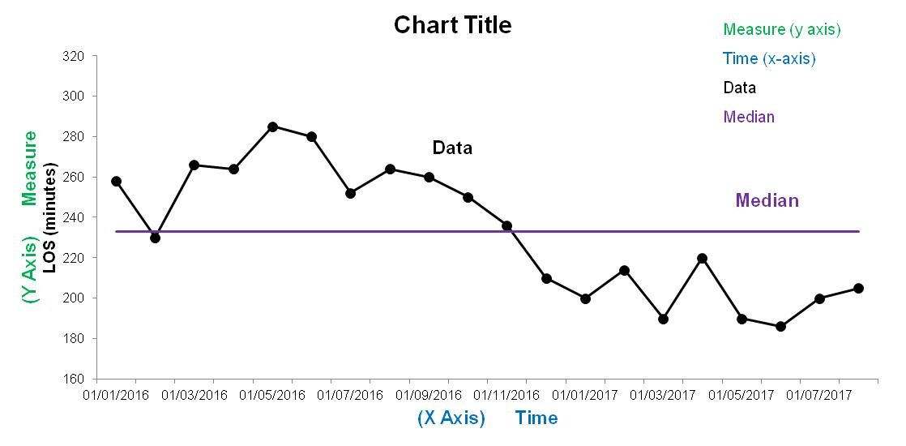
Elements of a run chart

Slide 22
Variation: Random or Non-random?
Random
Non-Random
Fluctuation of data caused by unknown natural factors that are inherent to the process
Affects everyone and all outcomes over time
Arises due to unexpected events that affect the distribution of data
Sporadic and unpredictable
Does not affect everyone or all parts of the system all of the time
Should be investigated in order to prevent recurrence

Slide 23
Run Chart Rules
Shift
Trend
Astronomical
Runs (too many to few)

Slide 24
Notes:
SHIFT
A shift (signalling change) is 6 or more consecutive points either all above or below the median.
Values that fall on the median neither add to nor break a shift – skip them and continue counting.
TREND
A trend (signalling change) is 5 or more consecutive points all going up or all going down.
A trend can cross the median.
Don’t count the starting data point.
If the value of 2 or more consecutive points is the same, only count one, ignore the like points when counting; like values do not make or break a trend.
TOO MANY TOO FEW RUNS
A run is a sequence of consecutive points which all lie on the same side of the median line - Ignore points exactly on the line (see reference table on next page to determine the expected number of runs).
Are there too many or too few for just common cause variation?
ASTRONOMICAL DATA POINT
An astronomical data point is one that is an obviously different value; anyone studying the chart would agree that it is unusual.
Every data set will have a highest point and a lowest point, but this does not necessarily make it “astronomical”.
It is worth understanding the cause of an astronomical point. This will allow you to emulate it if it is positive, or avoid / address it if it is negative.

Slide 25
Reactions to Variation
Random Variation?
Is it good enough?
(performance unacceptable)
Improve the process
Non Random Variation?
Investigate
Eliminate or emulate
Notes:
So how do we react to variation.
If we have random variation ask the question is it good enough, if so monitor it for any changes
If not, then improve the process, make use of diagnostic data (both qualititative and quantitative) and set an aim, develop a driver diagram (theory)
If we have non random variation this is where the learning comes from, as we should investigate and based on what we find we should either eliminate it or emulate it using improvement methodology.

Slide 26
Pitfalls to Avoid
Assuming you have a shift or a trend before you do
Over reaction to one data point
Not being able to explain outliers
Not being used as feedback
Not making it visible to the staff making the changes

Slide 27
What do we need to do?
To maximise the learning from the data and use it to improve Outcomes for CYP

Slide 28
What is your data telling you?
Data
Information
Insights
Action

Slide 29
How to tell your QI story
How to interpret the data
What data to collect
Identify what to measure
https://learn.nes.nhs.scot/3870/quality-improvement-zone/elearning

Slide 30
Dashboard Indicators linked to inspection
2.3 Health Needs Assessments for care experienced young people within 4 weeks
3.1 School leaver destinations for care experienced young people
3.2 Attainment for care experienced young people 5 @ 5*
3.3 Attendance or care experienced pupils
3.5 No of domestic abuse incidences with children – reported to SW
3.6a No. of pre-birth registrations babies affected by substance misuse
3.6b % of children affected by parental substance misuse on Child Protection Register
Notes:
Inspection demands and our shared preparations, maybe the Children's Rights Report a new duty and one we fully embrace –explicit in our 2nd annual report of the CSP, our desire to make our CPS 2020-23 better than our current plan maturing approach to understanding data trends, step change requirements in the LCPAR demand to shift spend and do things differently, how do we reconcile with existing demands and finite resources?

Slide 31
Data documents
QI1.1
JSNA
Shared Dataset
Dashboard – CSP indicators
CPC quarterly reports tracking key data
Notes:
Inspection demands and our shared preparations, maybe the Children's Rights Report a new duty and one we fully embrace –explicit in our 2nd annual report of the CSP, our desire to make our CPS 2020-23 better than our current plan maturing approach to understanding data trends, step change requirements in the LCPAR demand to shift spend and do things differently, how do we reconcile with existing demands and finite resources?

Slide 32
Self Evaluation Framework QI 1.1
Key factors – the extent to which partnerships are achieving:
Improvements in the safety and wellbeing of children and young people in need of protection.
Improvements in the wellbeing of children and young people for whom community planning partners have corporate parenting responsibilities.
Improvements in the life chances of care experienced young people up to 26 years
of age.
Notes:
Inspection demands and our shared preparations, maybe the Children's Rights Report a new duty and one we fully embrace –explicit in our 2nd annual report of the CSP, our desire to make our CPS 2020-23 better than our current plan maturing approach to understanding data trends, step change requirements in the LCPAR demand to shift spend and do things differently, how do we reconcile with existing demands and finite resources?

Slide 33
To what extent can we demonstrate
Positive and sustained trends (three years or more) in improving outcomes for children and young people in need of care and protection
Good use of reliable data measures is providing results that demonstrate improving outcomes over time for children in need of care and protection
Improved outcomes as a result of carefully gathered and analysed trend data which has been well used to understand cause and effect
Effective segmentation of measures has enabled the identification of improving outcomes and greater impact upon different groups of children and young people who are care experienced (including those children and young people looked after at home, away from home, in kinship care and so on)
Key measures demonstrate that children in need of protection are increasingly safer
The wellbeing of looked after children and young people is improving and the outcome gap between them and their peers is narrowing
Data shows that the life chances of care leavers are improving against a wide range of outcome indicators – shared dataset

Slide 34
QI 1.1 – key evidence
Shared dataset/JSNA - split into Child Protection and Corporate Parenting data
Dashboard data
PRF Q4 CSP
Community Plan
Child Poverty Action Report
CPC quarterly reporting
SLCPC annual report and business plan
Perceptual data Mind of My Own
Notes:
Inspection demands and our shared preparations, maybe the Children's Rights Report a new duty and one we fully embrace –explicit in our 2nd annual report of the CSP, our desire to make our CPS 2020-23 better than our current plan maturing approach to understanding data trends, step change requirements in the LCPAR demand to shift spend and do things differently, how do we reconcile with existing demands and finite resources?

Slide 35
Joint Strategic Needs Analysis- Key Points Activity
What are the pertinent issues for the partnership from the shared data set?
What data should feature in the Corporate Parenting dashboard?
Notes:
Inspection demands and our shared preparations, maybe the Children's Rights Report a new duty and one we fully embrace –explicit in our 2nd annual report of the CSP, our desire to make our CPS 2020-23 better than our current plan maturing approach to understanding data trends, step change requirements in the LCPAR demand to shift spend and do things differently, how do we reconcile with existing demands and finite resources?

Slide 36
Perceptual Data
Mind of my own/Viewpoint
RCS Wellbeing Survey
SALSUS data
Staff surveys
Notes:
Inspection demands and our shared preparations, maybe the Children's Rights Report a new duty and one we fully embrace –explicit in our 2nd annual report of the CSP, our desire to make our CPS 2020-23 better than our current plan maturing approach to understanding data trends, step change requirements in the LCPAR demand to shift spend and do things differently, how do we reconcile with existing demands and finite resources?

Slide 37
Data Webpage
Plans & Strategies
Annual Reports
Dashboard
JSNA
Q4 Improve Reports
Other data
Link ________________

Slide 38
Next Steps
Bespoke dashboards for thematic sub groups – Test with Corporate Parenting Sub Group
Further develop the shared dataset
Understanding of JSNA
What else?

Slide 39
Thank You

